Slide 1

Give us your feedback to make this course better!

Slide 2

R Programming Language
Introductory course for statistical data analysis
ຈັດສອນໂດຍ: ອານາວິນ ສີມຸກດາ

Slide 3
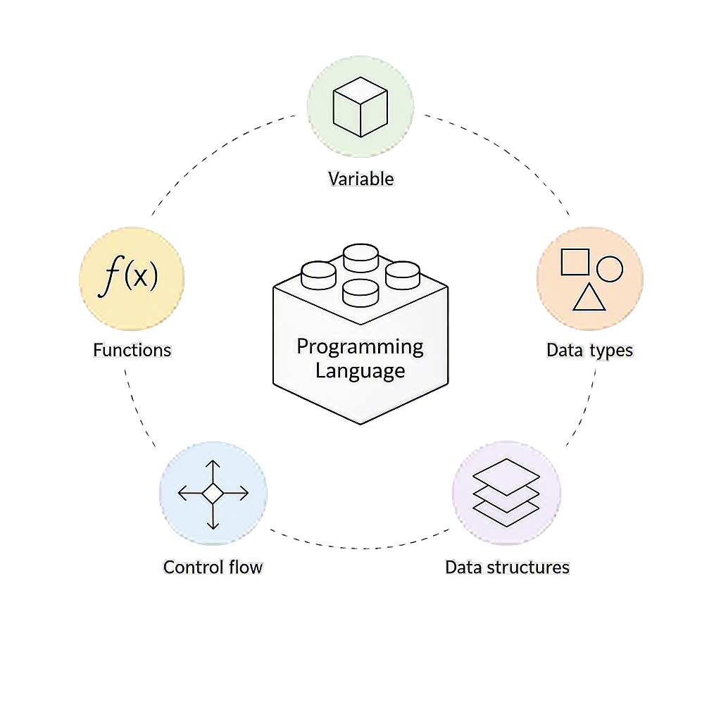
💢 ໃນການຂຽນໂປແກມທຸກໆພາສາ, ຈະມີ Core Building Block ຫຼັກໆ 5 ຢ່າງ:

Slide 4

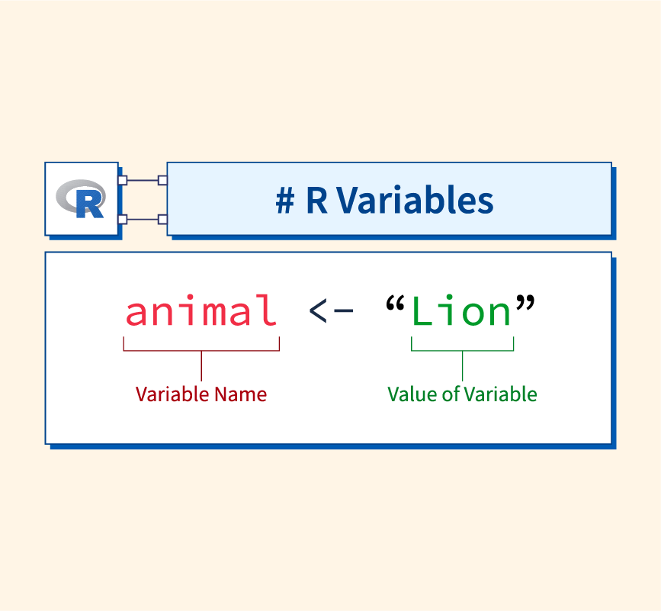
📁 Variables / Objects ແມ່ນຫຍັງ
🚩 ສິ່ງທີ່ ໃຊ້ເກັບຂໍ້ມູນ ຫຼື ຜົນລັບ ໄວ້ໃນໜ່ວຍຄວາມຈຳເພື່ອໃຫ້ເຮົາ ສາມາດເອີ້ນມາໃຊ້ພາຍຫຼັງໄດ້ 🚩
Plots from ggplot2 visualization code
Dataset 1
Filtered / transformed data
Dataset 2
List of object
Ex. “Golden Retriever”, “Samoyed”, “Shiba”, “dachshund”

Slide 5
🫣 ມາທຳຄວາມຮູ້ຈັກກັບ Data type ແຕ່ລະຊະນິດໃນ R
Dplyr:
glimpse() Meaning Example
<chr> String “Anawin”, “E. coli”, “LOMWRU”, “11 51 91 - ຫມາ”
<dbl> double/numeric 25.4492, 10.54, 0.05, 1240, 39
<int> integer 9, 20, 32, 48, 1980, 1998
<date> date 2026-08-25, 1998-04-15
<fct> factor “Infant”, “Children”, “Adult” | “0”, “1”, “2”
<lgl> logical TRUE, FALSE

Slide 6
🧩 ໂຄງສ້າງຂອງ Data / Data Structure
ໃນພາສາ R ຈະມີ data structure ຫຼາຍຊະນິດເຊັ່ນ: vector, list, matrix, arrays, data frame
Vector Data frame
Structure 1D 2D (rows × columns)
Contains Values Column
Types Usually one type Different types per column
Examples c (1, 2, 3) data.frame (x, y)
Think of it as A list of value A table (same as excel file)

Slide 7
What have we learnt so far week 1
Different data types: string, numeric, factor
How to create vector with function c ( )
How to import data with read.csv( )
How to create data frame with data.frame ( )
How to use dollar sign $ to access column in object df$gender
How to check structure of data with function str ( )
Assignment: create a R script, then create vector of 5 objects (should contain different data types)
  Then use data.frame () function of 5 objects and store it in df object

Slide 8
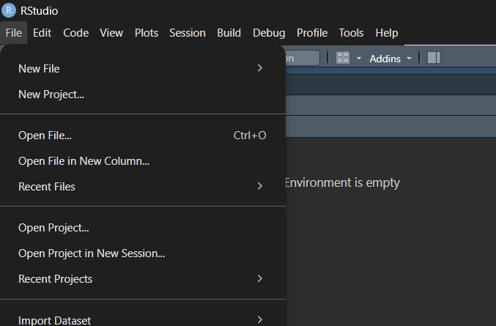
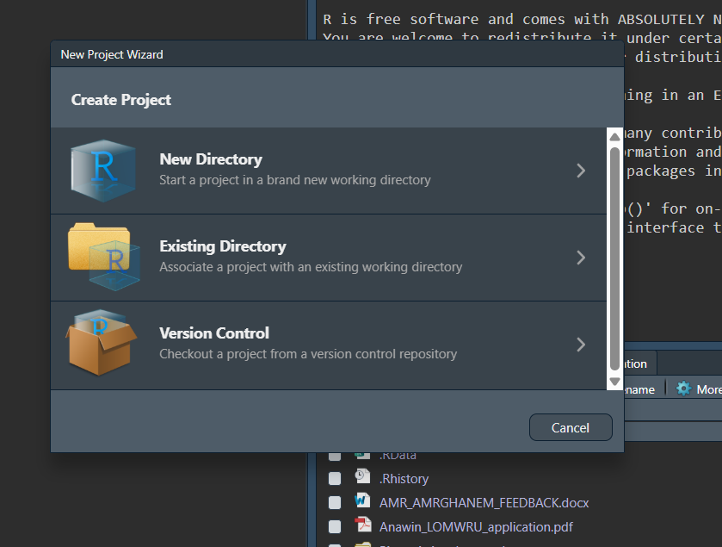
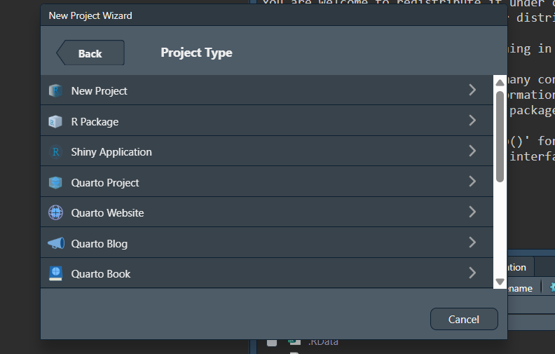
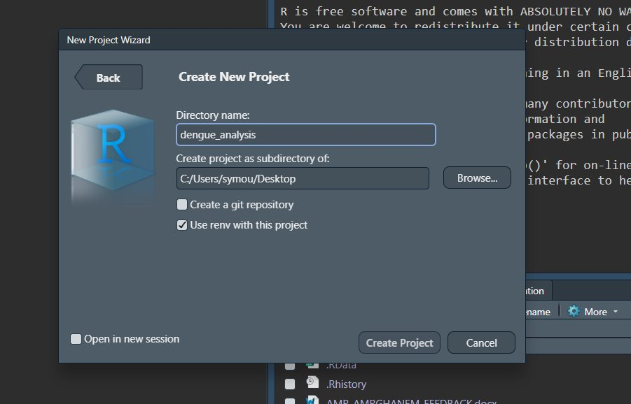
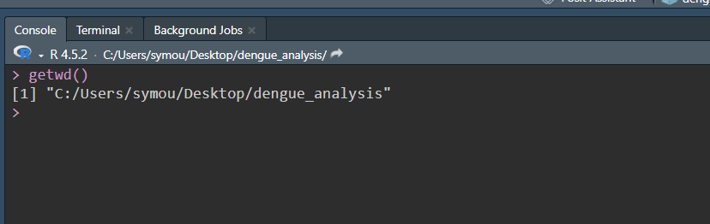
👌ການສ້າງ directory/folder ໃນການວິເຄາະຂໍ້ມູນ​
1. File -> New Project
2. Create new directory
3. Choose new project
4. Browse to choose where to locate our directory and name them
✨ getwd( ) - function to locate where is our directory

Slide 9
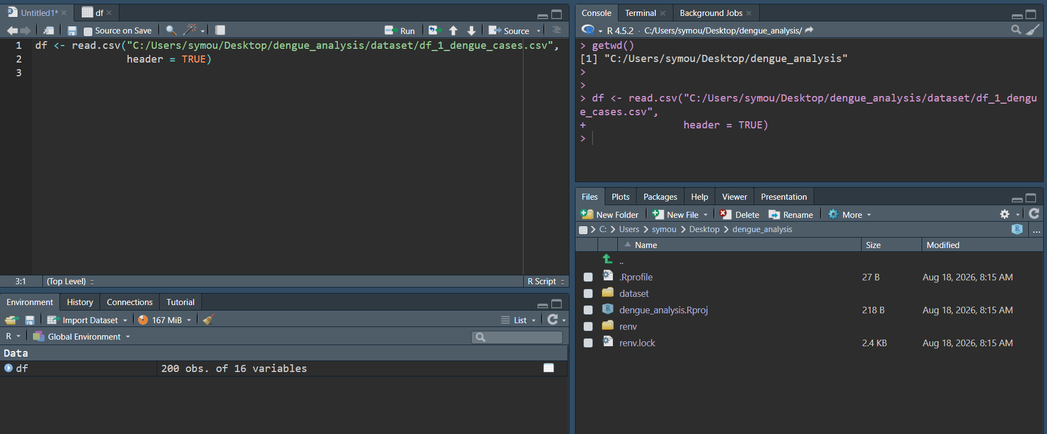
🌸 how to import CSV file in R​
Function to read comma separated value (CSV)
Locate where is our directory
Checking our directory where is locate our csv file
Write the full path of file location in the read.csv function
Assign it to variable (df)
✨ read.csv(file = “file_location”,
header = TRUE )
1
3
2

Slide 10
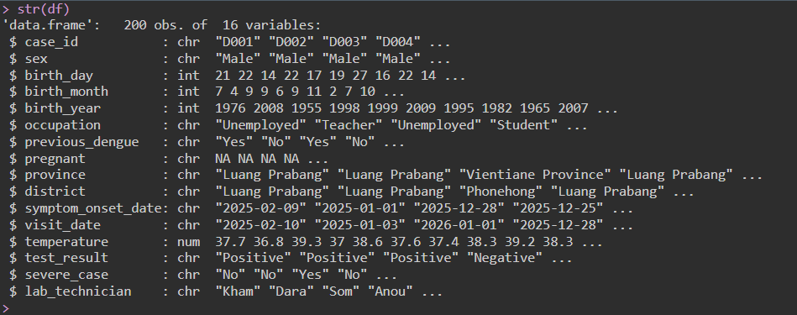
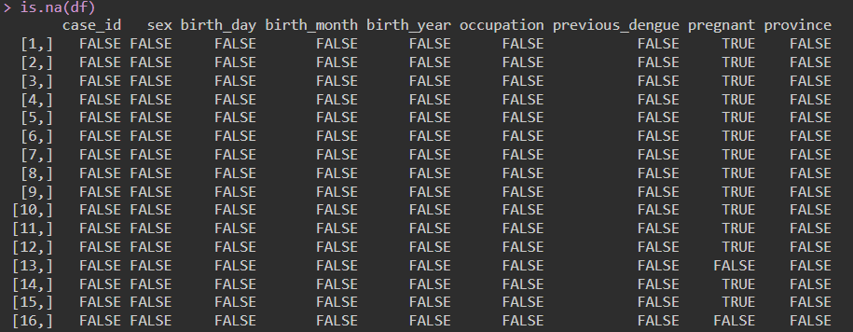
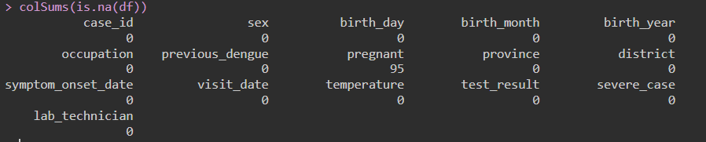
🐶 function to get to know our data​
Suppose our data frame is stored in variable called df
✨
View (df) – function to open new tap to overview our full data
nrow (df) - function to count how many rows are there in the data
ncol (df) - function to count how many column are there in the data
str (df) - function to check the structure of our data
length (df) - number of elements in a vector/column in a data frame
is.na (df) – showing TRUE/FALSE of each value in df if it has Na value
sum(is.na (df)) – sum or count total Na value in the df
colSums(is.na (df)) – showing how many Na value in each column
colNames (df) – show the name of each column

Slide 11
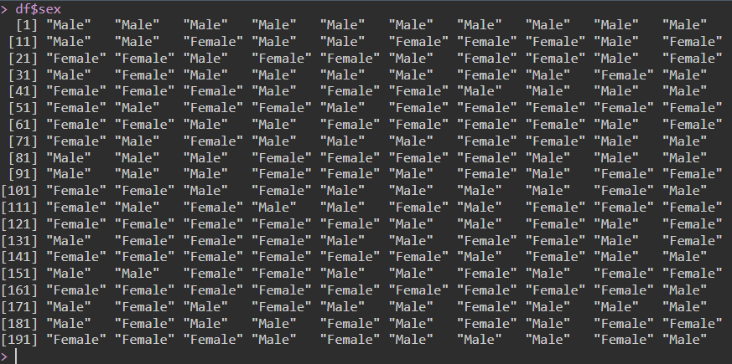
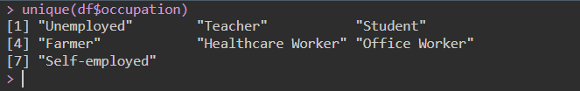
🙉 how to subset our data
✨
$ - dollar sign after variable will subset a column from the df and store it as vector
It is powerful when we combine it with function
✨
unique ( ) – function to find a unique value in a vector (“Male”, “Female”)
Ex. unique(df$sex)
length (df$sex) == nrow(df) - function to count the total rows in df

Slide 12
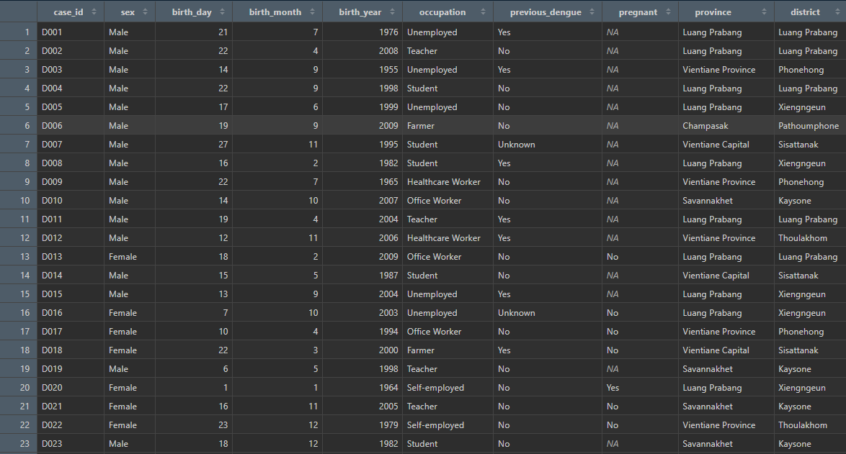
Let’s say how do we do if we want to subset data to get the first 10 rows from the column occupation?

Slide 13
✨
df [ rows, columns ]
To subset first row from 1st column - df [ 1, 1 ]
To subset row 1-10 from 3rd column - df [1:10, 3]
To subset row 15-30 from column 2-5 - df [ 15:30, 2:5 ]
4. What if we want to subset all rows but only from column 2, 4, 6?
df [ , c(2,4,6)] - space to select all items in the vector
✨
c ( ) – function to combine multiple values or objects into a single vector or list.
5. What if we want to subset all column but only from rows 1-20?
df [1:20, ]
6. What if we know the name of the column (case_id, sex, occupation, province) and we want all rows from those column?
df[ , c("case_id", "sex", "occupation", "province")]

Slide 14
✨
🐱 from subset to filter data​
Mathematical operation in R
== equal
!= not equal
<, <= smaller, smaller or equal
>, >= bigger, bigger or equal
+, -, *, /
& and
| or
We use dollar sign $ to select vector in column
We use square bracket [ ] to subset data
Now its time to combine those two together !
Suppose we want to subset data from all column, but only the row in column sex equal to female, how do we do?
df [df $ sex == ‘’Female”, ]
Now we want all column but all rows in occupation column who is “Teacher” and in sex column who is female?
df [df $ occupation == ‘’Teacher” & df $ sex == “Female”, ]

Slide 15
🌸 Assignment week 2​
From a dengue dataset, we want to subset data to get all column when sex is “Female” and province from “Savannakhet”
  - How many observations are they ?
2. What are the unique value in column “province”?
3. From dengue dataset, I want to get row 2, 6, 8 ,22 from 4 columns (case_id, previous_dengue, pregnant, test_result)

Slide 16
🦖 check and convert data type​
To check class of object we use function class ( x )
✨
✨
as.integer ( ) – function convert data type to integer
as.character ( ) – function convert data type to string
as.factor ( ) – function convert data type to categories but can’t manually set the level of value
levels( ) – function to check the levels/hierarchical order of factor data
df$column <- factor (df$column, levels = c(“…”, “…” )
df$sex <- as.factor (df$sex, levels = “Male”, “Female”)
“levels” parameter in function factor ( ) will assign the
category like 0, 1, 2 to the value in our variable automatically

Slide 17

🐸 String concatenation – a way to join the strings​
Operation on numeric data
x <- 4
y <- 2
print(x + y)
Operation on string data
x <- “4”
y <- “2”
print(x + y)
> we will get the output: 6
> we will get the output: error
So how do we connect or link the two strings together?
✨
x <- “4”
y <- “1”
paste (x, y, sep = “.”)
paste ( ) – function to connect strings together
The output is
“4.1”
paste (x, y, sep = “any symbol”)

Slide 18
In R, a library is a collection of functions, datasets, and other resources that extend the basic capabilities of R.
Libraries allow you to use additional tools without having to write all the functions yourself.
For example, the ggplot2 library provides functions for creating graphs and visualizations.

Slide 19
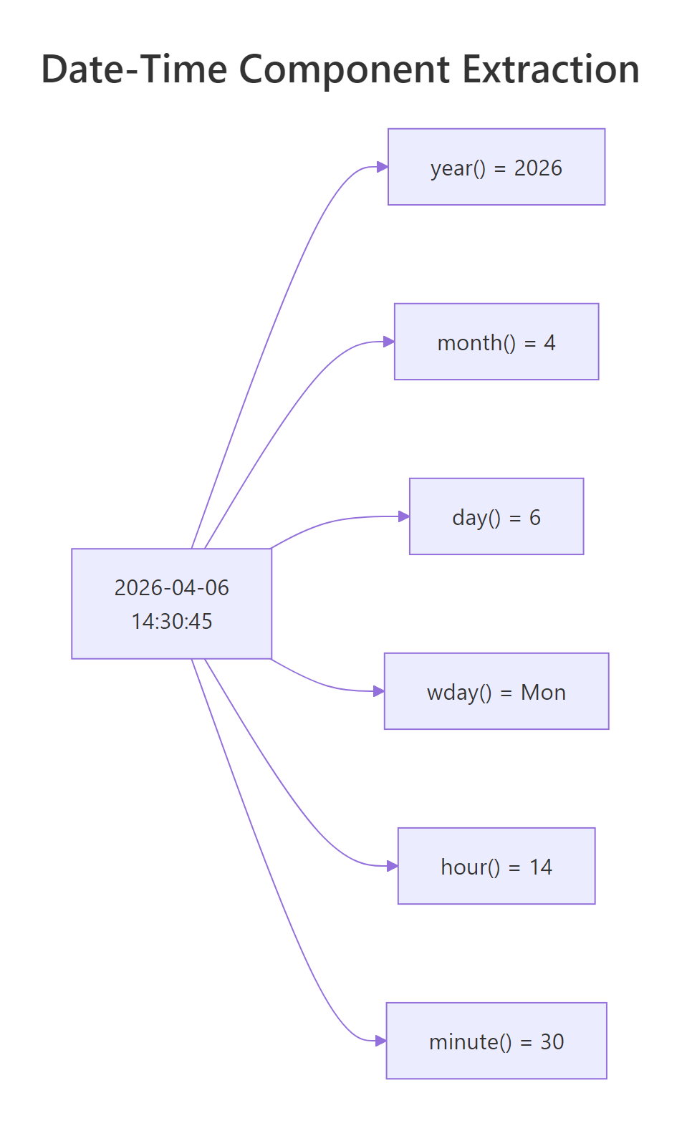
📆 lubridate: date data will not be a headache for you anymore

Slide 20
📆 lubridate – will make your life easier dealing with date data​
Suppose our data has column: birth_year, birth_month, birth_day
we want to find out how old are they, what is your approach?
Approach 1 – String concat then convert to date
Approach 2 – collapse all columns and create a date
✨
✨
# y-m-d format
df$birth_date <- paste(df$birth_year, df$birth_month,
df$birth_day, sep = “-”)
# y-m-d format
Library (lubridate)
df$birth_date <- make_date(
year = df$birth_year,
month = df$birth_month,
day = df$birth_day
)
library (lubridate)
df$birth_date <- ymd(df$birthday)

Slide 21
Now we get the date data already, how do we use this information to find the age of our observations?

Slide 22
4. floor () - takes a number and rounds it down to the nearest whole number
floor () x round ()
floor() always goes down.
ceiling () always goes up
round() goes to the nearest whole number.
3. time_length () – How long is this time interval, in the unit specifed?
Ex. time_length(
two_point_of_time,
default unit == “second”)
# “days”, “months”, “years”
✨
floor ( time_length ( interval( df$date, today ( ) ), “years” ) )
2. Interval () – creates a time span between two points in time
Ex. Interval between our birthdate and today’s date
1. today () – function to get today’s date
df$age <- floor ( time_length ( interval( df$date, today ( ) ), “years” ) )

Slide 23
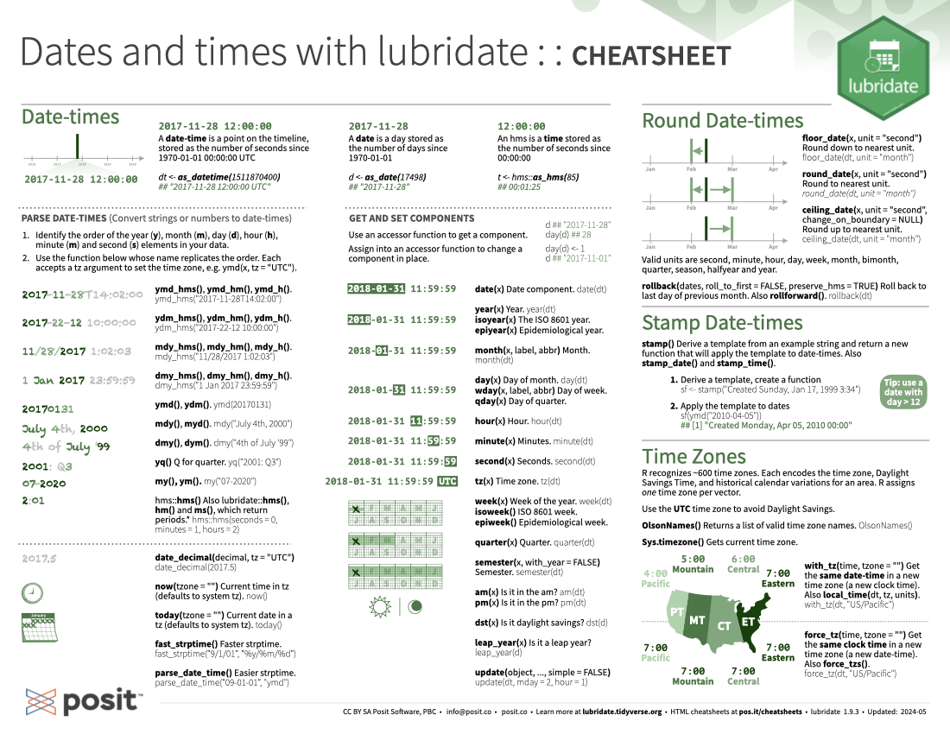
Extracting parts of date date
✨
year (``date``) - extract year from date data
month (``date``) - extract month from date data
day (``date``) - extract day from date data
Convert strings to date
✨
ymd("2026-08-21")
dmy("21-08-2026")
mdy("08-21-2026")
https://rstudio.github.io/cheatsheets/html/lubridate.html

Slide 24
🌸 Assignment week 3
Convert categories in column “province” to factor with the reference province is “Savannakhet”, the rest order is up to you
  example approach: Savannakhet (1), Champasak (2) . . .
Convert data type of birth_year to integer, then find the average year using function mean() of all participants
Create a new column in a dataset called “work_n_sex” and do string concatenation of column “occupation” and “sex”, connected with “-”
example outcome: “Teacher-Male”
4. We want to find out how many days does it take for them to have the first symptoms of dengue until visit date?

Slide 25
💢 ໃນການຂຽນໂປແກມທຸກໆພາສາ, ຈະມີ Core Building Block ຫຼັກໆ 5 ຢ່າງ:

Slide 26
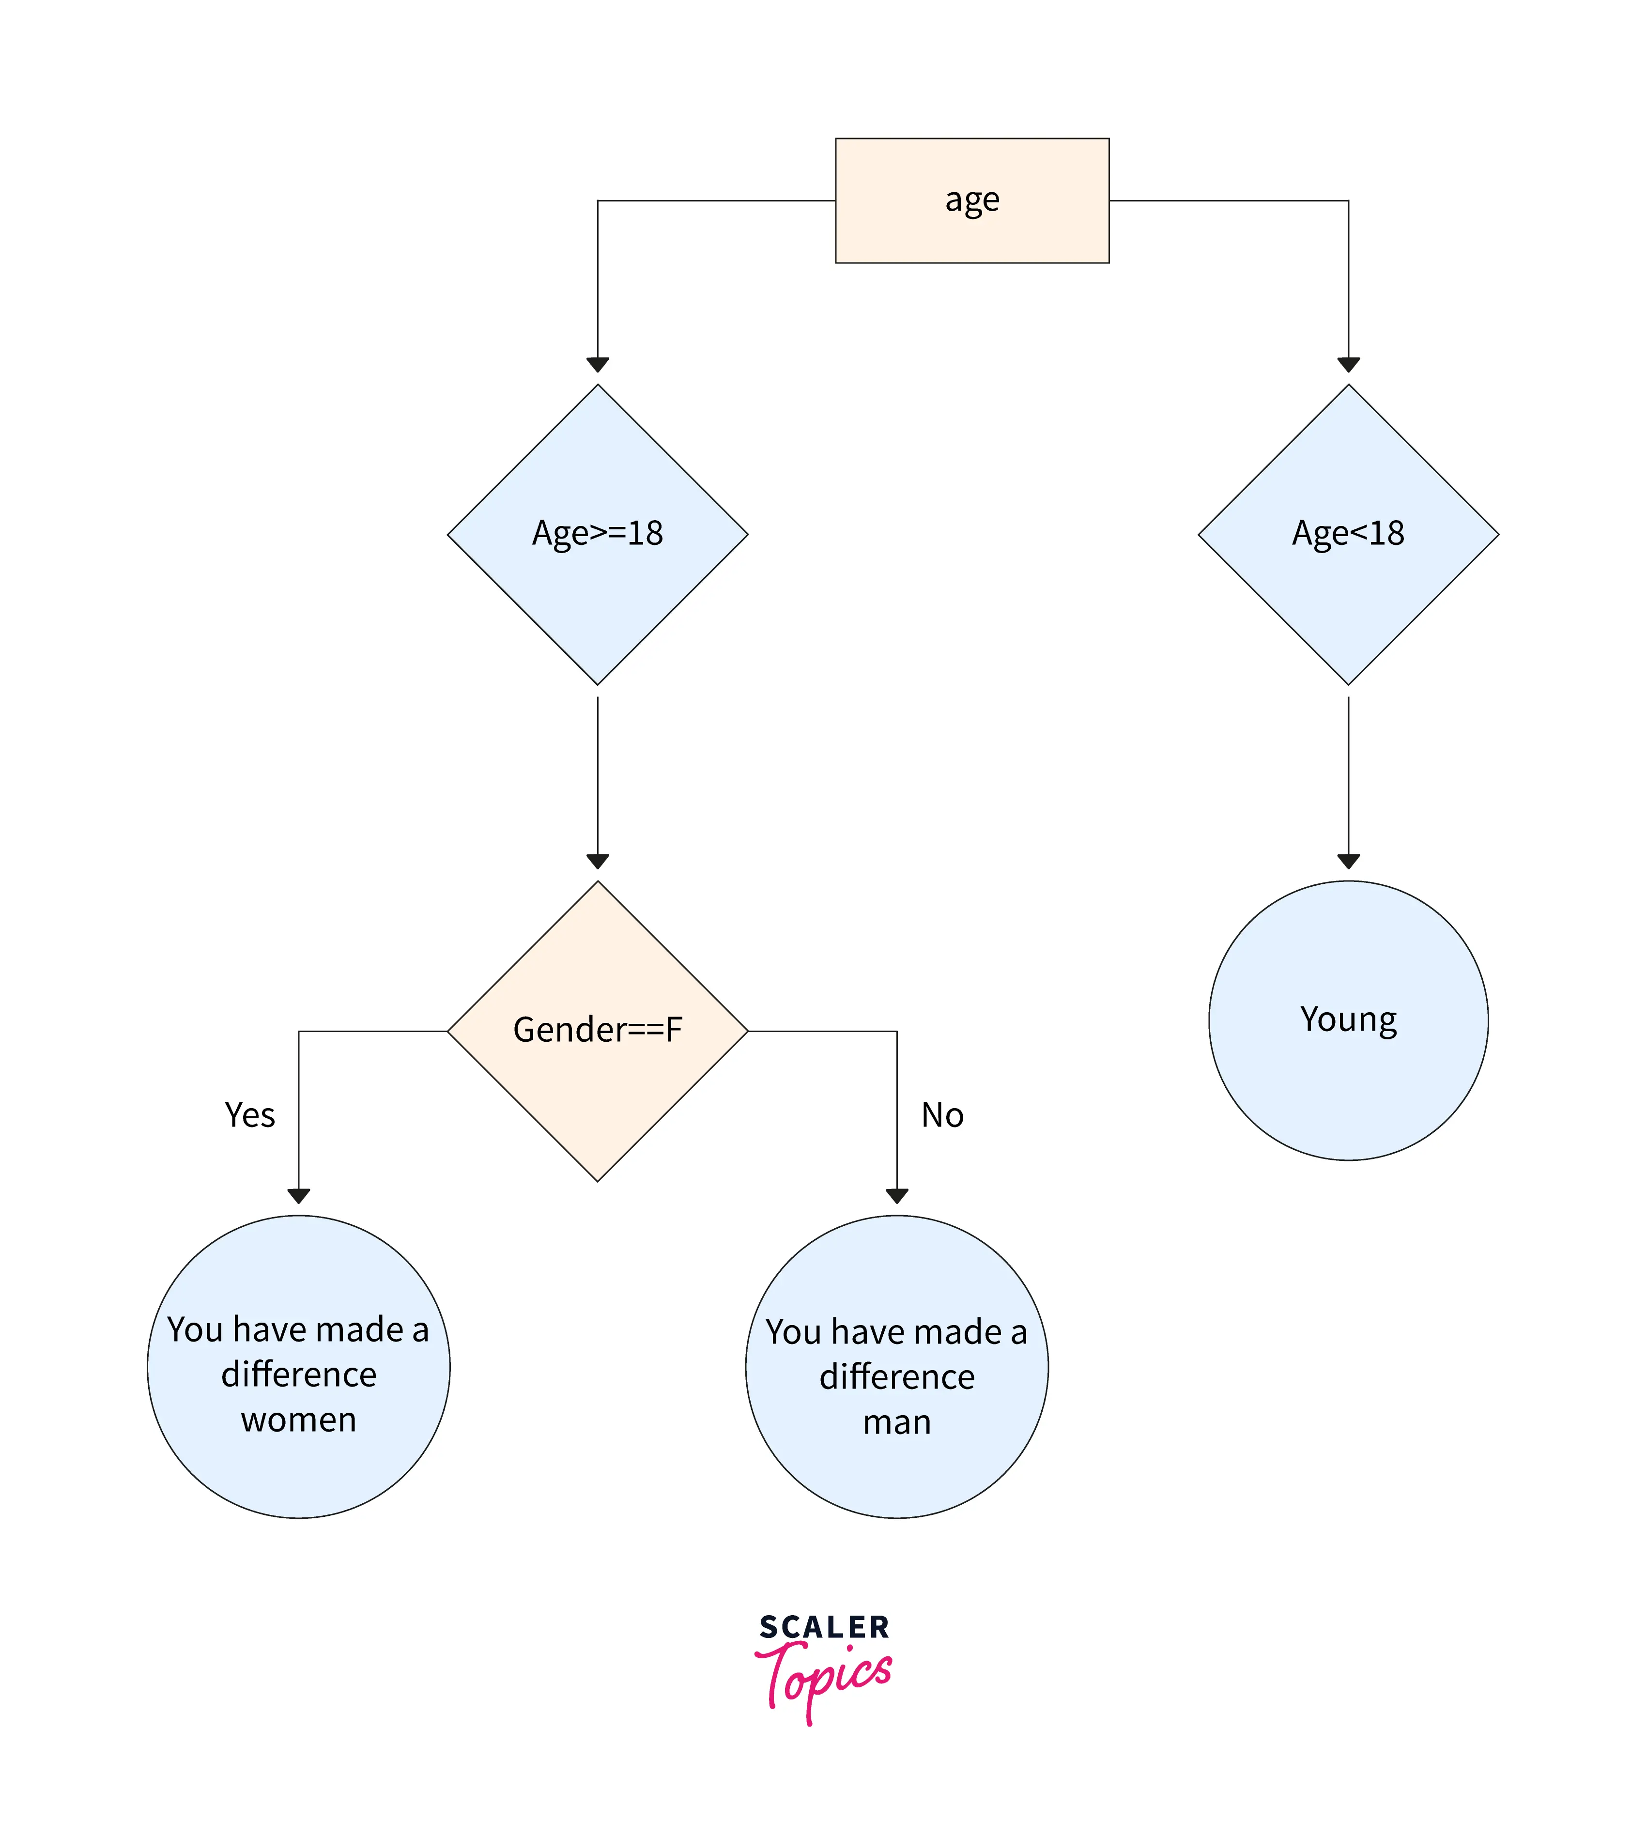
🔄 ລຳດັບການເຮັດວຽກໂປແກມ Control Flow
ໝາຍເຖິງຄຳສັ່ງທີ່ໃຊ້ຄວບຄຸມທິດທາງການເຮັດວຽກຂອງ code ໃຫ້ເຮັດຕາມເງື່ອນໄຂ (if / else) ຫຼື ເຮັດວຽກຊ້ຳ - loop (for / while)

Slide 27
When we want to categorize age into age group we use ifelse condition
Multiple ifelse condition
✨
ifelse(
condition_1,
result_1,
ifelse(
condition_2,
result_2,
result_3
)
)
Singular ifelse condition
✨
ifelse(
condition,
value_if_TRUE,
value_if_FALSE
)
df$age_group <- ifelse(
df$age < 20, # first condition
"Teenager", # TRUE
ifelse(
age <= 40, # second condition
"Adult", # TRUE
"Senior" # FALSE
)
)
df$age_group <- ifelse(
df$age < 25,
“young”,
“old”
)

Slide 28
👀 Exploratory Data Analysis (EDA)
👉🏻 is the process of looking at a new dataset to understand its main features, spot mistakes, and find patterns using simple charts and summary numbers before making any decisions.
We had already done some EDA already
Ex. str(), length() ...

Slide 29
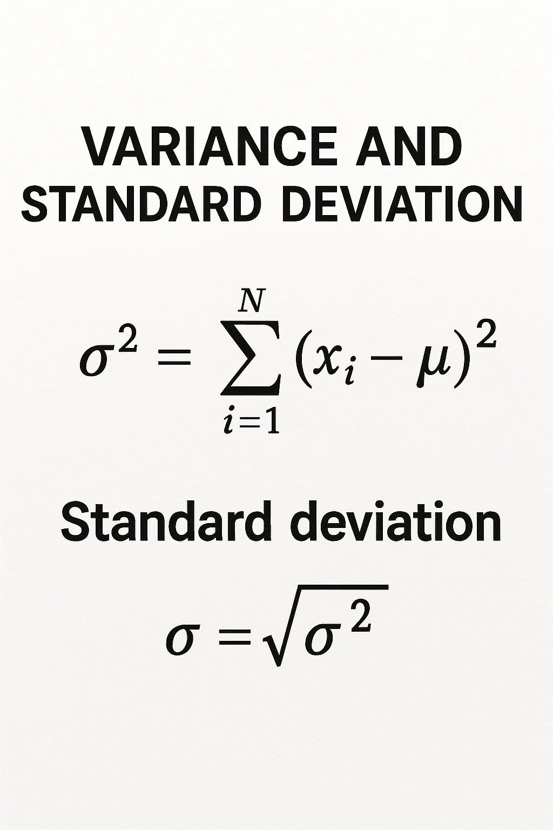
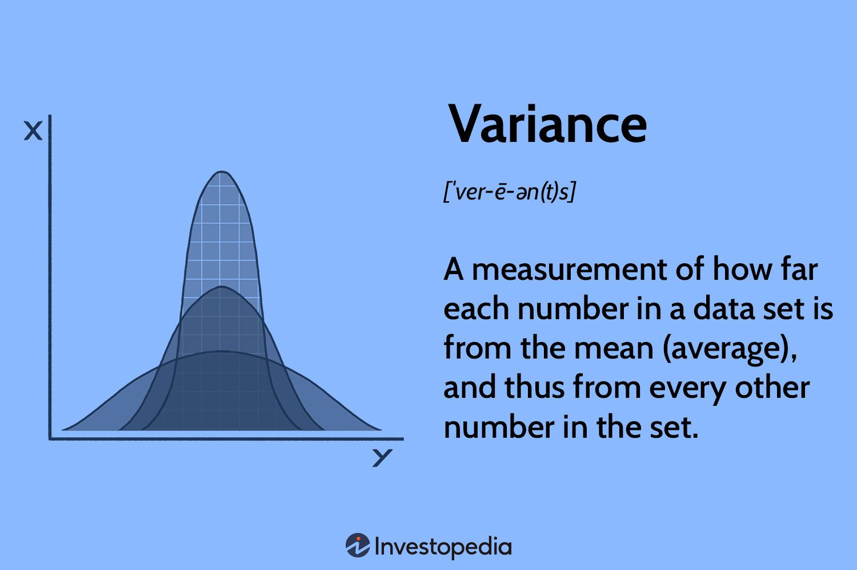
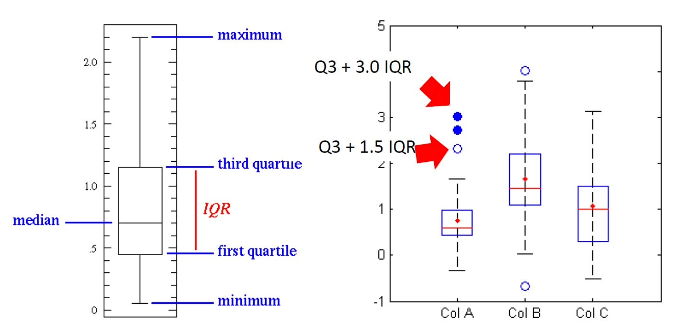
💯 EDA on continuous variables
✨
summary(df$``column``) – function to give brief summary overview
mean ( ), median( ), range( ), quantile(x, 0.25), quantile (x, 0.75)
hist(df$``column``) – showing distribution of data by histogram plot
var(df$``column``) - measures how spread out the data values are from the mean
sd (df$``column``) - function to find standard deviation
boxplot (df$``column``, coef = . . . ) - function to show the boxplot distribution of data with interquartile range, default coef is x1.5

Slide 30
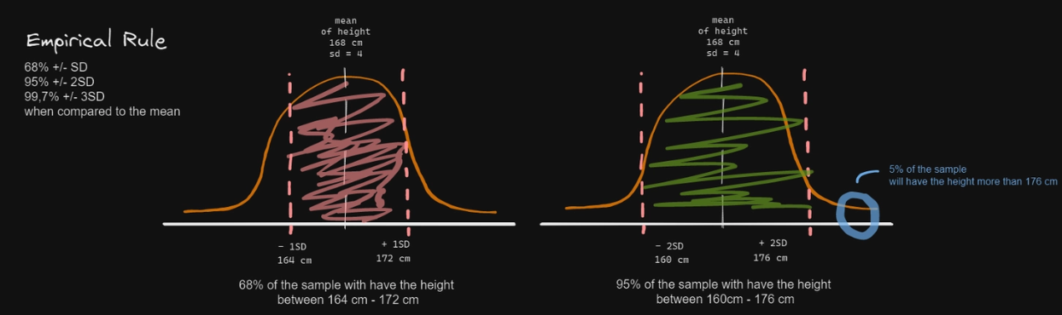
💁 Empirical rule – a rule for data that follows an approximately normal/bell-shaped distribution.

Slide 31
Question: What if we have 10 continuous variable and we want to do the same thing will we write the same code all over and over again?

Slide 32
💢 ໃນການຂຽນໂປແກມທຸກໆພາສາ, ຈະມີ Core Building Block ຫຼັກໆ 5 ຢ່າງ:

Slide 33
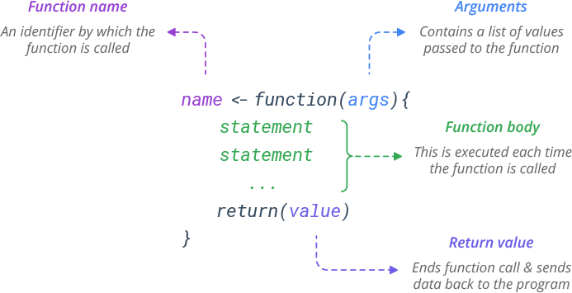
⚙️ Avoid repetitive coding using Function

Slide 34
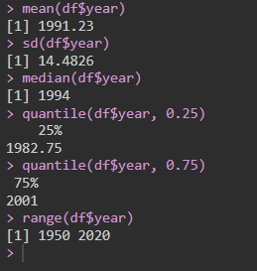
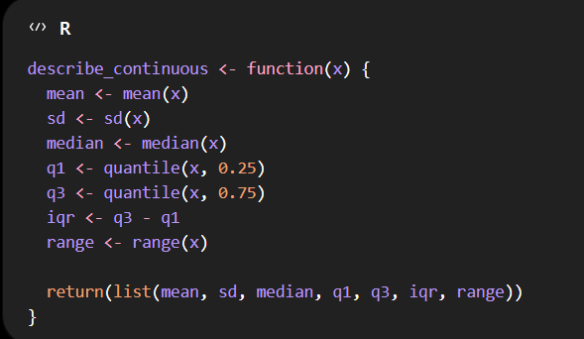
⚙️ Avoid repetitive coding using Function
ຖ້າສົມມຸດວ່າເຮົາຕ້ອງຄິດໄລ່ຄ່າພວກນີ້ກັບ number set ອື່ນໆ ເຮົາຈະຂຽນແບບເກົ່າຫຼາຍໆເທື່ອບໍ່ ?
We can turn it into function !

Slide 35
🌸 Assignment week 4
Following the 4th question from week 3 assignment after creating a column to find out how many days does it take for them to have the first symptoms of dengue until visit date?
  We want to see the histogram and boxplot visualization of the time length after first symptom until the visit date
  We want to know what is its average, median, standard deviation, minimum, maximum
  Is the data normally distributed (bell shaped curve) or skewed?
  Then create a function to find out the same thing with another continuous variable “age”, “temperature”
Categorize if the time after the admission to hospital, if it is less or equal than two days -> it is “appropriate”. If it is more than 2 days -> it is “late”.
  If it is equal or more than 3 day, it is “extreme late” and assign in any column name that you like

Slide 36
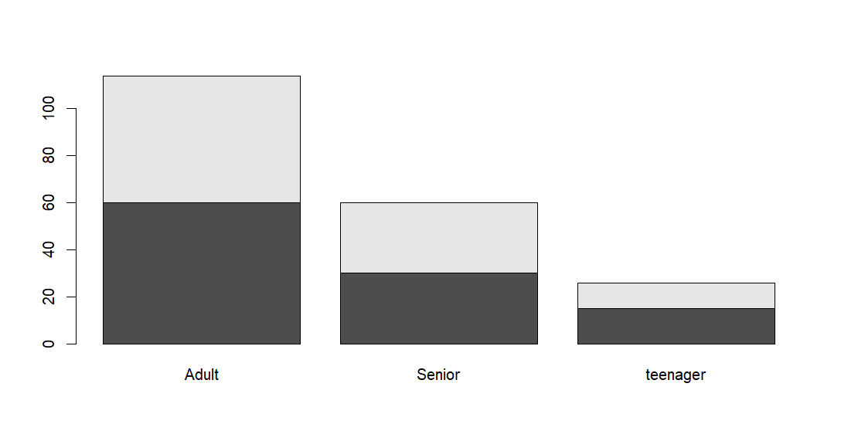
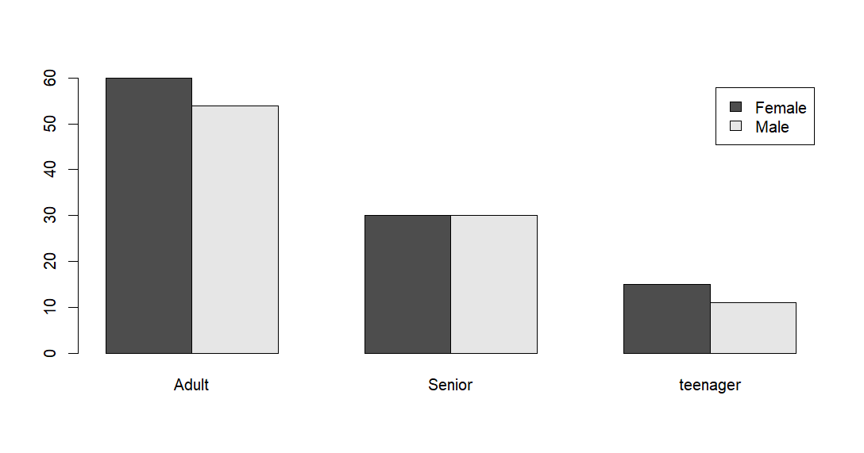
🧟 EDA on categorical variables
beside = FALSE, legend = FALSE
✨
table (x, y)– create cross tabulation of two categorical variables
addmargins (table (x, y)) – add rows and column totals
prop.table ( …., margin = 1) – create row proportions / margin = 2 – column proportion
round (…., 1) – round percentages to 1 decimal place, 2, 3, 4 ...
barplot (
table(df$sex, df$age_group),
beside = TRUE,
legend = TRUE,
xlab = “…”,
ylab = “…”,
main = “…” # add title
)
beside = TRUE, legend = TRUE

Slide 37
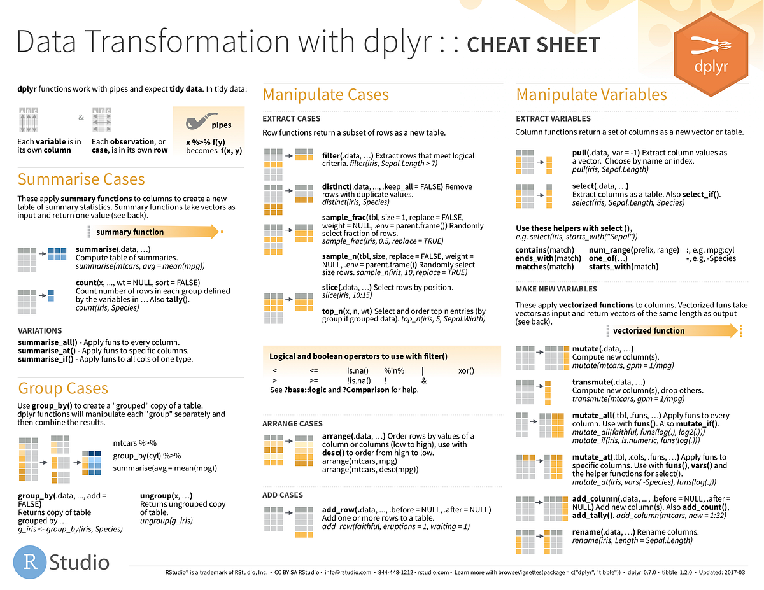
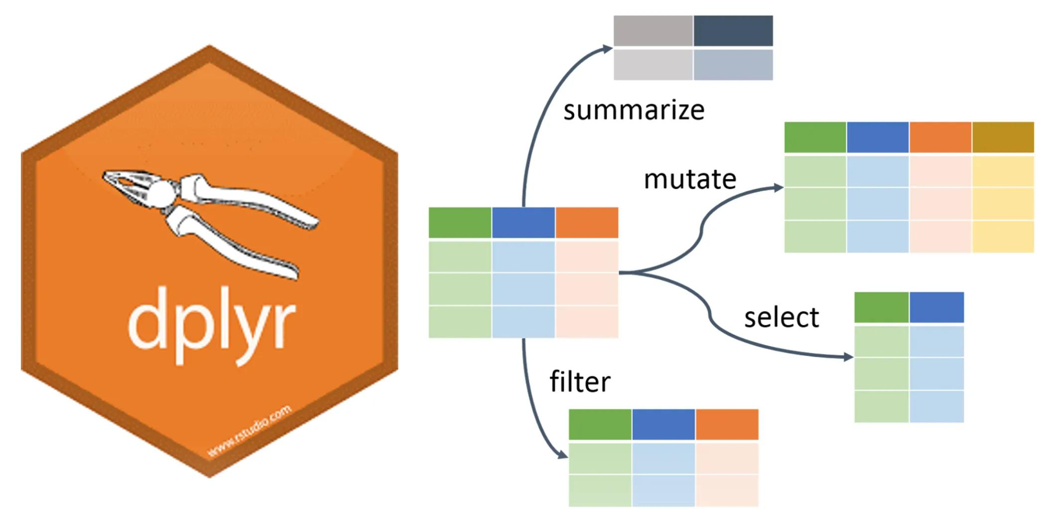
🔥 Dplyr: The most used and powerful library in R for data transformation
https://dplyr.tidyverse.org/

Slide 38
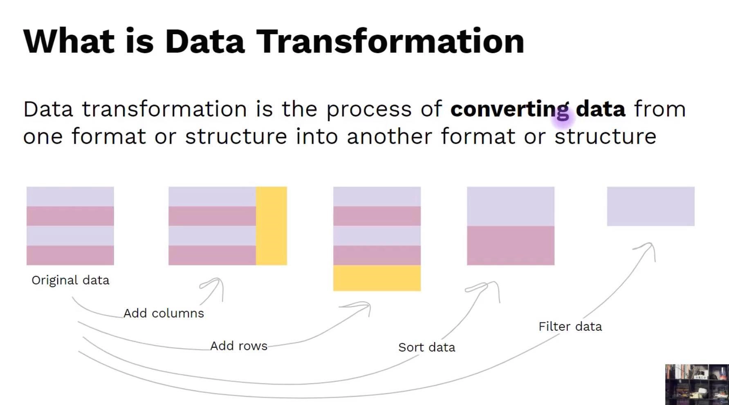

Slide 39
In dplyr library, we will use the specific syntax called “pipe” operator, “%>%”
But first let’s install a package and call the library to our environment to use them
✨
install.packages ( “dplyr”)
library (dplyr)

Slide 40
🦖 most important function from dplyr!
✨
select () – to select columns
slice () – to select rows
filter () – to filter data with conditions
mutate () – to create new column or modifying existing column
case_when () – very similar to ifelse()
arrange () – sort default “smallest to largest”, desc() to do the opposite
group_by () – to categorize the value in the column
summarize () – summarize information across rows
rename () – to change column name
library(dplyr)
df %>%
select (case_id, sex, occupation) %>%
slice (c(1:30, 35:50)) %>%
filter (sex = “Male”, previous_dengue == “No”) %>%
mutate ( age_group = case_when (
age >= 60 ~ “very old”,
age >= 40 ~ “old”,
age >= 20 ~ “little old”,
TRUE ~ “we are GENZ”) %>%
arrange (desc(age))
library(dplyr)
df %>%
mutate (
sex = factor(sex, levels = “Male”, “Female”)) %>%
group_by (sex, age_group) %>%
summarize (
temp_mean = mean (temperature)) %>%
rename(temp_mean = mean_temp)

Slide 41
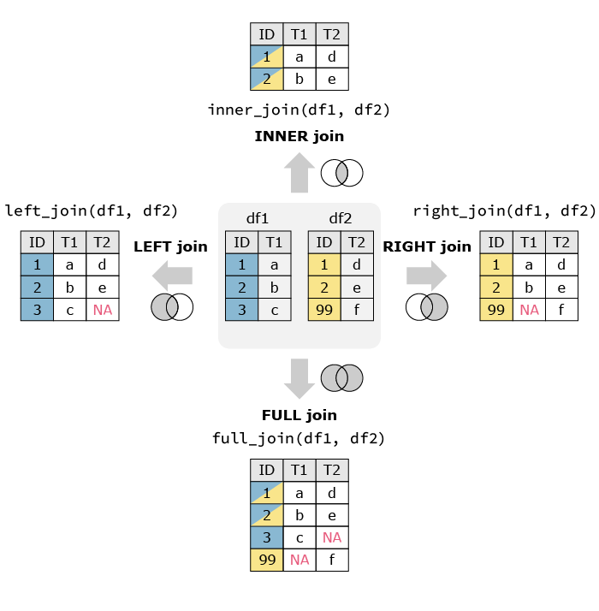
✨Joining two datasets: different types of join
✨
library (dplyr)
new_df <- dataset1 %>% left_join(
dataset2, by = c(column_df1 = column_df2)
)

Slide 42
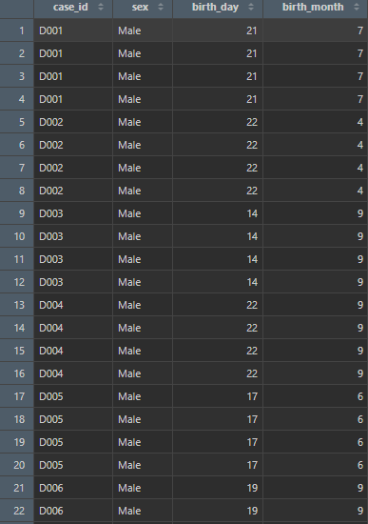

Scenario 1: descriptive on long-format data
we want to count how many males and females in dataset then calculate the avg temperature of the two groups:
df %>%
group_by (sex) %>%
summarise(
temp_avg = mean(temperature),
count = n())
But are these values correct? . . .

Slide 43
It is very useful to convert a long format data to wide format data first!

Slide 44
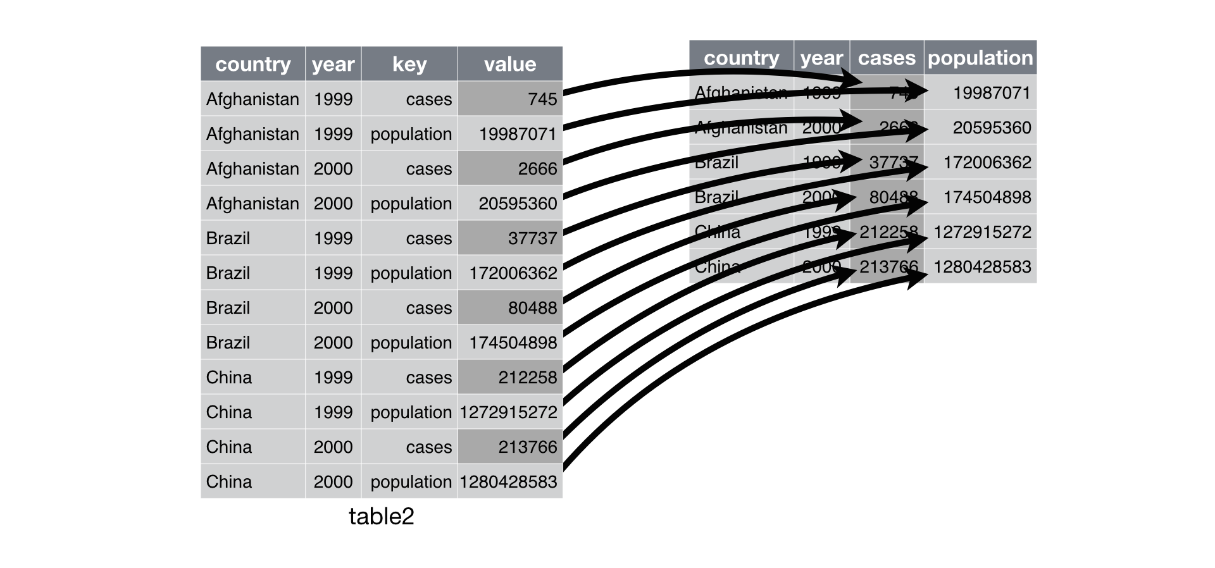
✨ tidyr: a magic that turn a messy data into a tidy and clean one “long-wide format”

Slide 45
✨
library(tidyr)
df %>%
pivot_wider ( # convert data long to wide format
names_from = symptom, # specify value in the column that will be the new column names
values_from = present # specify the value in the column used to fill newly created col
)
This approach is okay if you have a clean long format data like this:
However it does not work if you have data like this:
case_id | symptom | Present
D001 | headache | 0
D001 | vomit | 0
D002 | headache | 1
D002 | vomit | 0
D003 | headache | 0
D003 | vomit | 1
case_id | symptom
D001 | headache
D002 | headache
D002 | Vomit
D003 | headache
D003 | Vomit
D003 | Diabetes

Slide 46
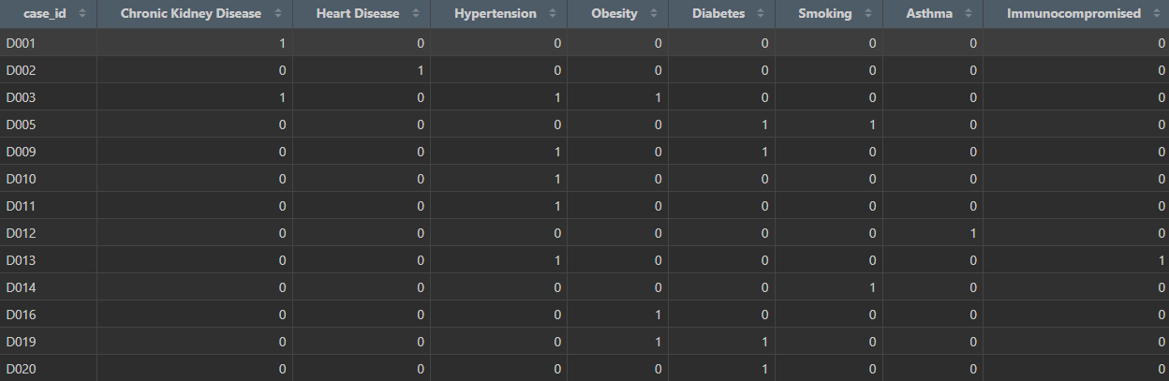
✨
library(tidyr)
df %>%
pivot_wider ( # convert data long to wide format
names_from = comorbidity, # Makes comorbidities into column names
values_from = comorbidity, # Uses comorbidity values as the data source
values_fn = ~1, # Assigns 1 when present
values_fill = 0 # Fills missing combinations with 0
)

Slide 47
🌸 Assignment week 5 – Categorical EDA, data transformation – dplyr, joining, pivot data
Categorical EDA
Please find out how many people in each province have positive and negative test result
What are the proportion ? (both report in row and column percentage)
Create a bar plot to show the distribution
Data transformation – using dplyr!
I want to see in the transformed data the columns (caseid, sex, age, age group, occupation, pregnant, dengue positivity (test result))
I want you to filter data to get only pregnant woman
Then create new column called “agemorethan20”, which then the create a condition if the age more than 20 assign “Yes”, otherwise “No”
Then relocate this column to the third position
I want to know what is the average age of this transformed data
Join our data with “df_2_dengue_cases_ver2.csv”, then rename the column “comorbidity” to “disease”,
Please change longformat data to wide format data and assign 1 if a disease present, otherwise 0

Slide 48
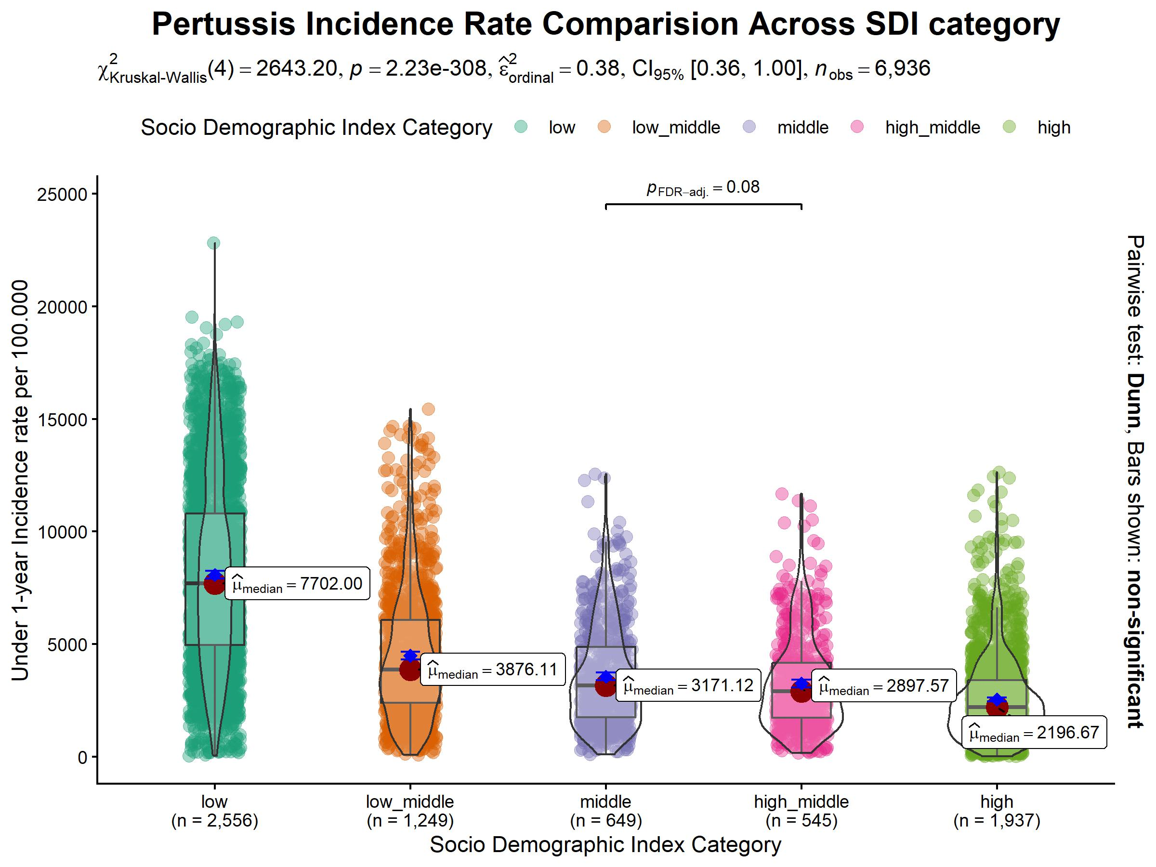
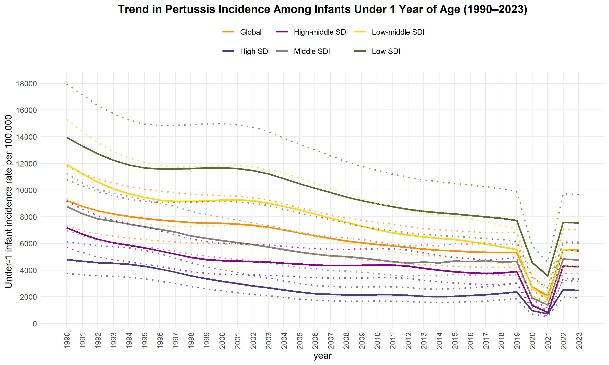
🎨 ggplot2: data visualization

Slide 49
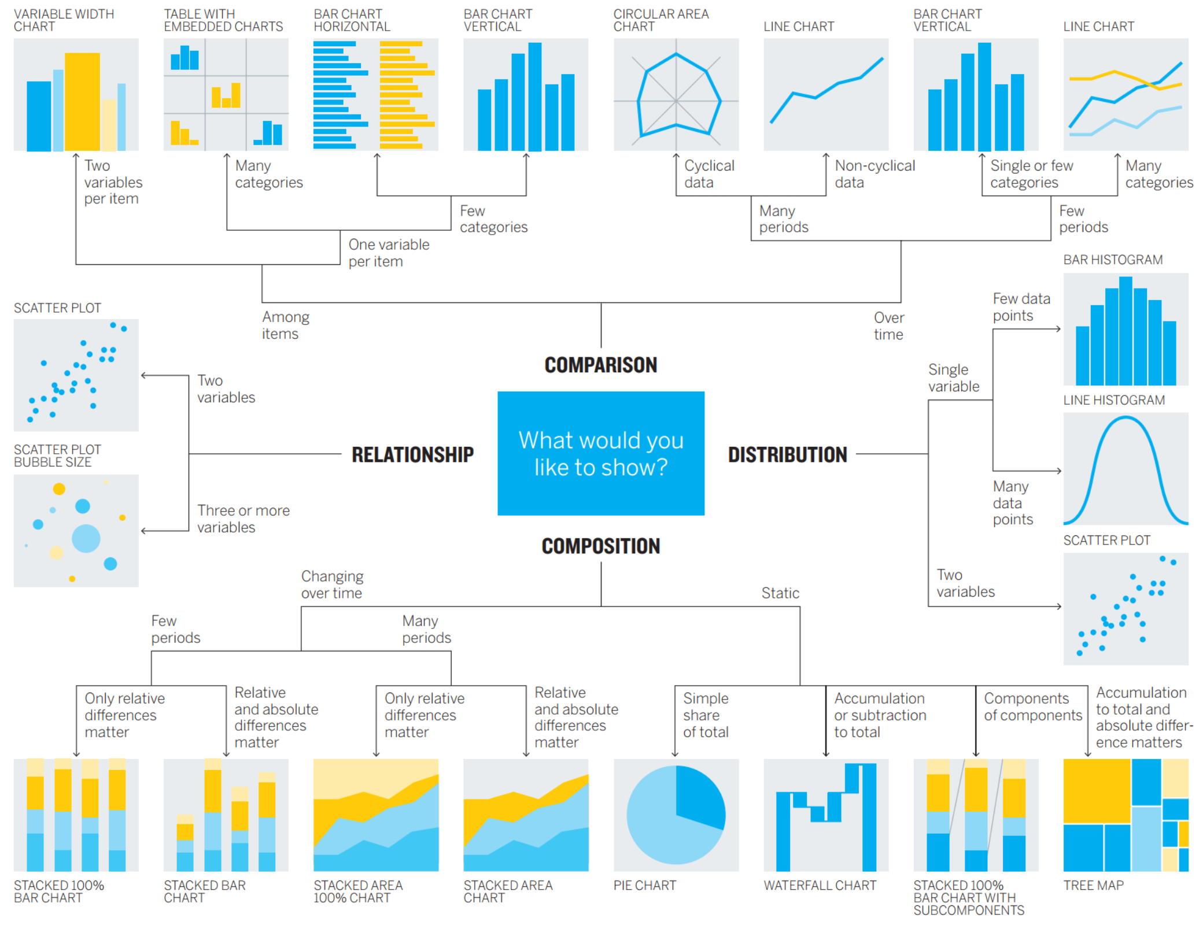

Slide 50
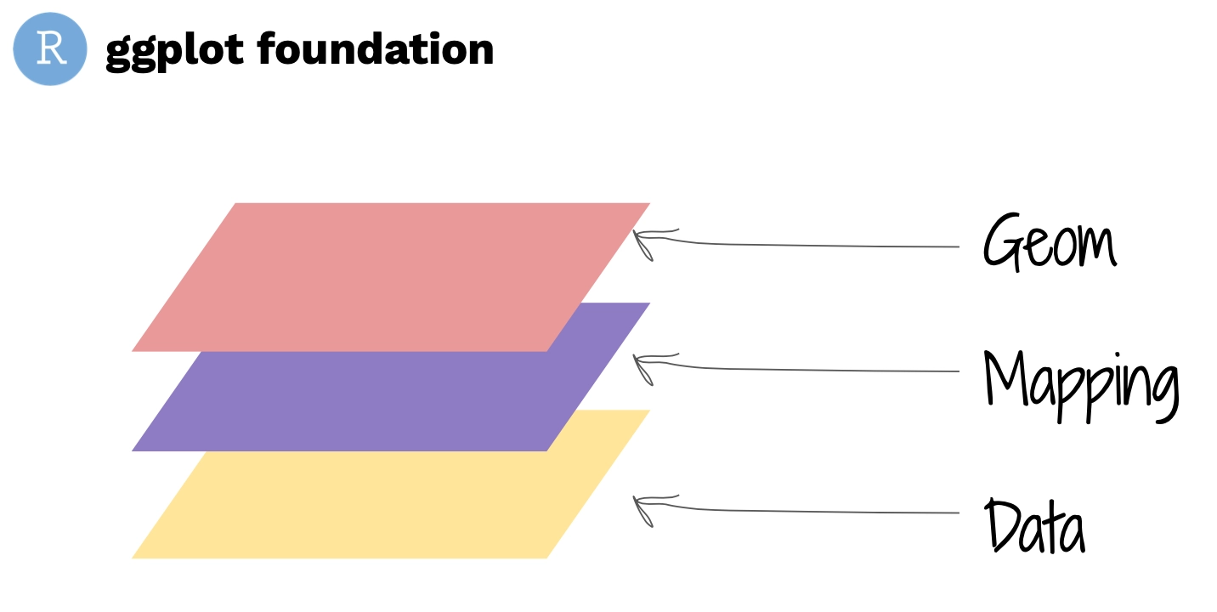
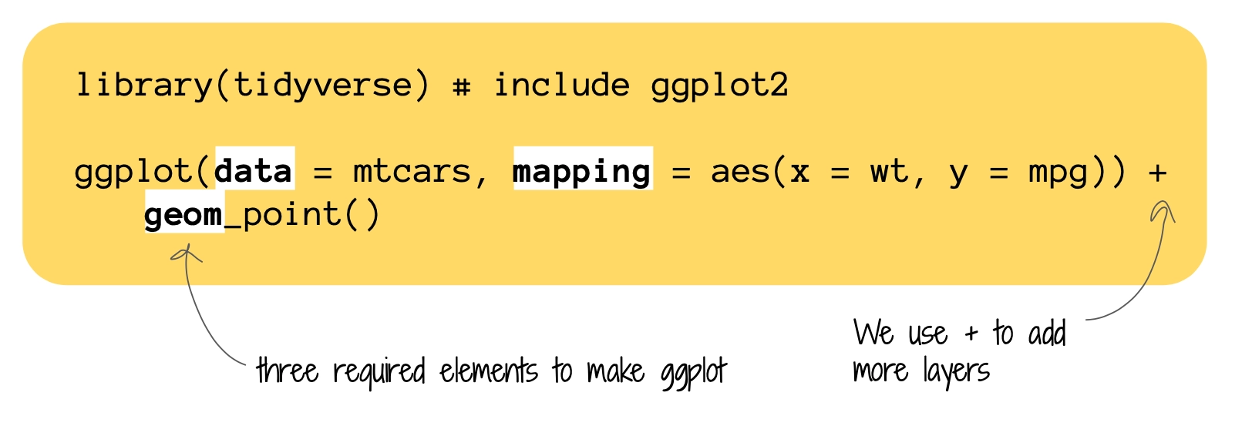
🎨 ggplot2: let’s create an art on a canvas !
https://ggplot2.tidyverse.org/articles/ggplot2.html#coordinates
Notes:
The idea behind ggplot2 is that we build a graph layer by layer. At the beginning, we need to tell ggplot2 three basic things:
Data: What dataset are we using?
Mapping: Which variables do we want to visualize, and how should they be mapped to the graph?
Geom: What kind of visual representation do we want, such as points, bars, or lines?

Slide 51
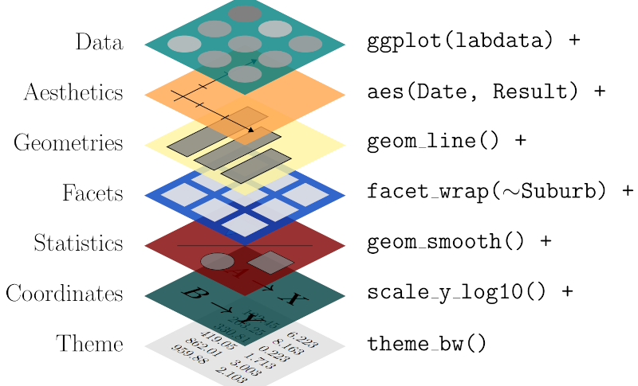
😰 The real one is even more complex ! 😭
🥳 But ! It will be okay because we have our best friend, AI 🤖

Slide 52
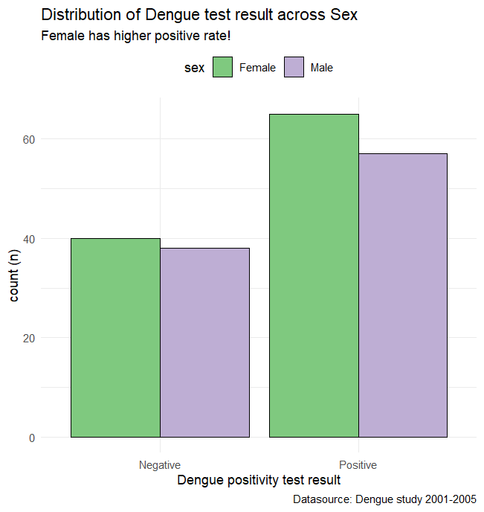
🧟 geom_bar () – 1 categorical variable – 2 bar chart comparison
ggplot(df_viz,
aes(test_result, fill = sex)) +
geom_bar(position = "dodge", color = "black") +
theme_minimal() +
labs(
title = “...",
x = “...",
y = “...",
subtitle = “...",
caption = “...") +
scale_fill_brewer(type = "qual", palette = 1) +
theme(
legend.position = "top")
geom_bar ( ) – to create a barplot
- default with fill = show the stacked bar filled with selected variable, if add position = “dodge”, display next to each other

Slide 53
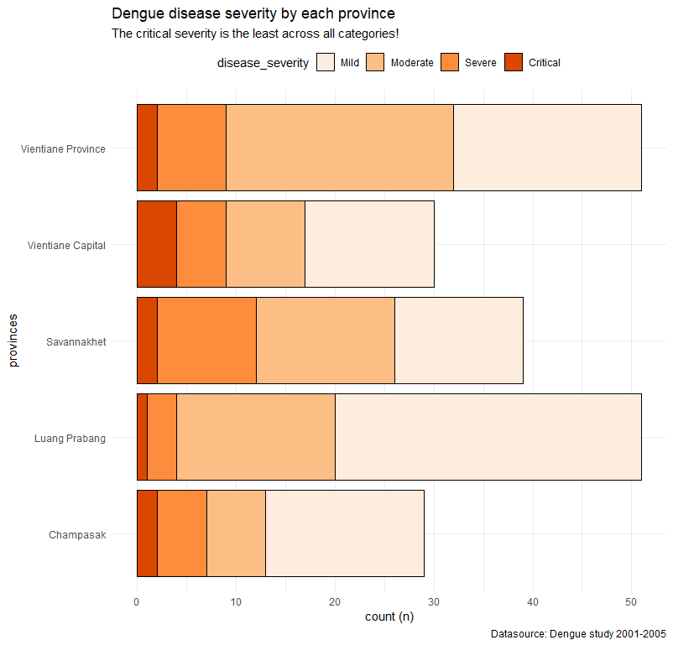
🧟 Dataviz – 1 categorical variable – stacked bar plot
Same code but change the aes() with different variables
Remove argument ``position = “dodge”`` from geom_bar ( )
Remove argument ``type = “qual”`` from scale_*_brewer ( )
+ coord_flip( ) – will change from vertical display to horizontal

Slide 54
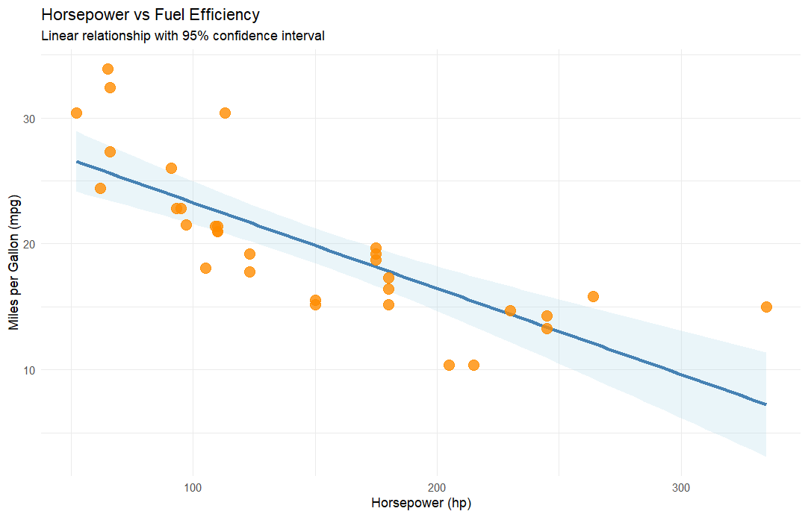
🧟 geom_point () – 2 continuous variables – scatter plot
ggplot(df_viz,
aes(x = ..., y =...)) +
geom_point( ) +
geom_smooth (method = “lm”, se = TRUE)
geom_point ( ) – to create a scatter plot of 2 continuous variables
-geom_smooth ( ) – add trend line to our plot, with
method = “lm” – add linear line
se = TRUE – show 95% CI

Slide 55
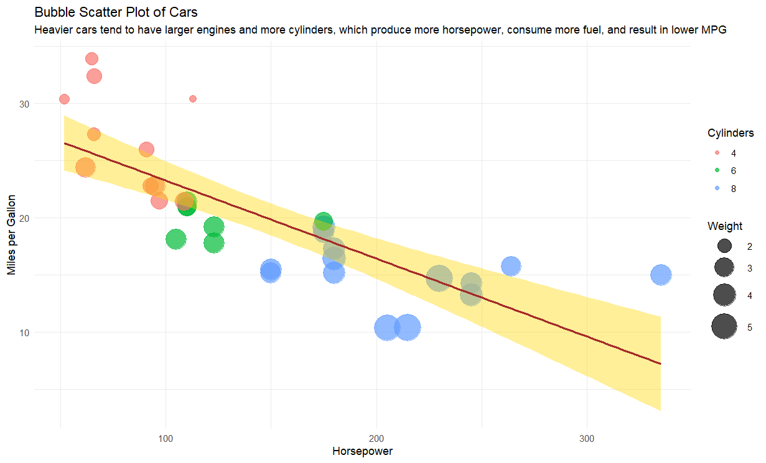
🧟 geom_point () – 2 continuous variables – scatter plot with fill and shape
ggplot(df_viz,
aes(x = ...,
y =...,
col = ...,
size = ...)) +
geom_point( ) +
geom_smooth (method = “lm”, se = TRUE,
aes(group = 1)
aes(group = 1) in the geom_smooth ( ) will tell the program to create only overall linear line, not separately for each group

Slide 56
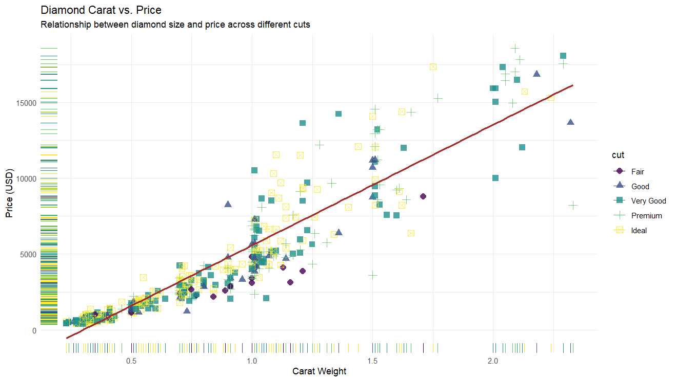
🧟 geom_point () – 2 continuous variables – unlock full potential of scatterplot
ggplot(df_viz,
aes(x = ...,
y =...,
col = ...,
shape = ...)) +
geom_point( ) +
geom_smooth (method = “lm”, se = TRUE,
aes(group = 1) +
geom_rug ( )
geom_rug ( ) will show the different color of data on the x and y axis

Slide 57
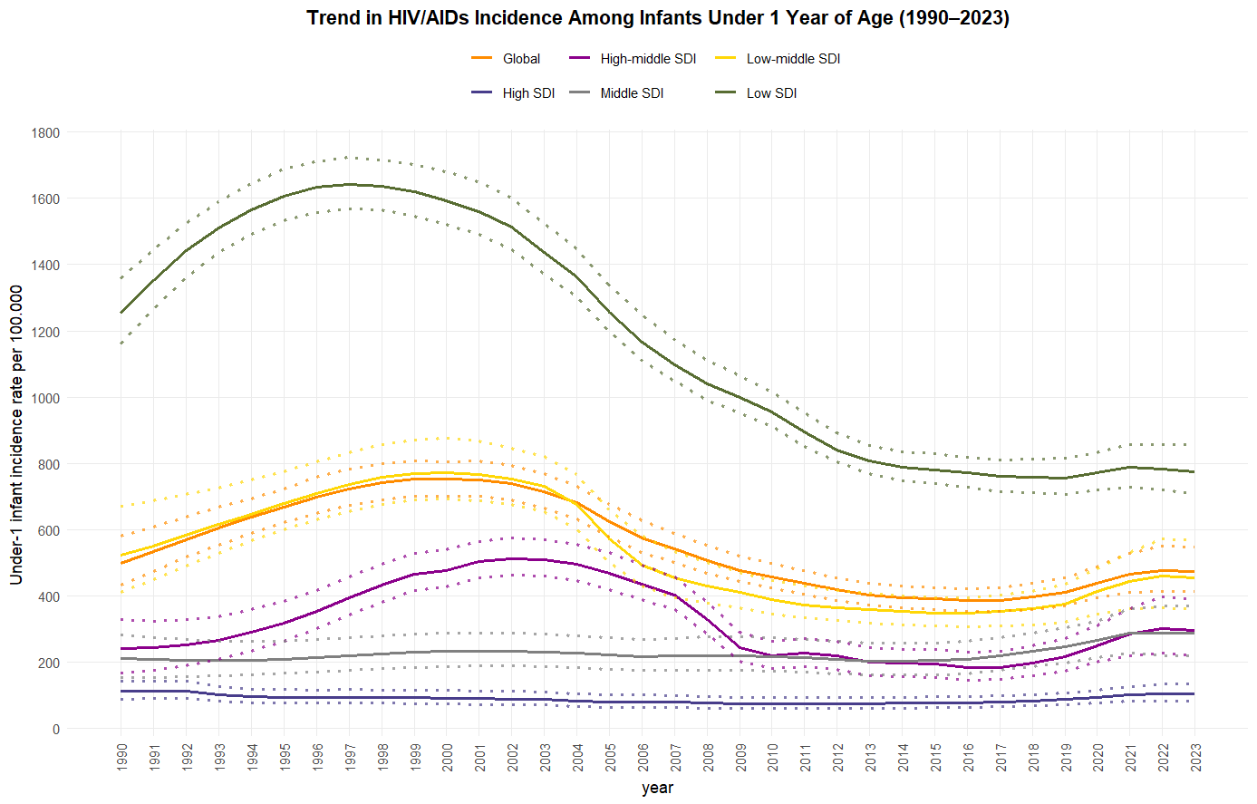
🧟 geom_line () – continuous time trend
ggplot(df_viz,
aes(x = ...,
y =...,
col = ...,
group = ...)) +
geom_line( )
``group =`` tells ggplot which observations belong together when drawing a line. If you don't tell ggplot how to group them, it may treat the observations as one group and try to connect all the points.
``geom_line( )`` connect the value to each other
Notes:
group tells ggplot which observations belong together when drawing a line. If you don't tell ggplot how to group them, it may treat the observations as one group and try to connect all the points.

Slide 58
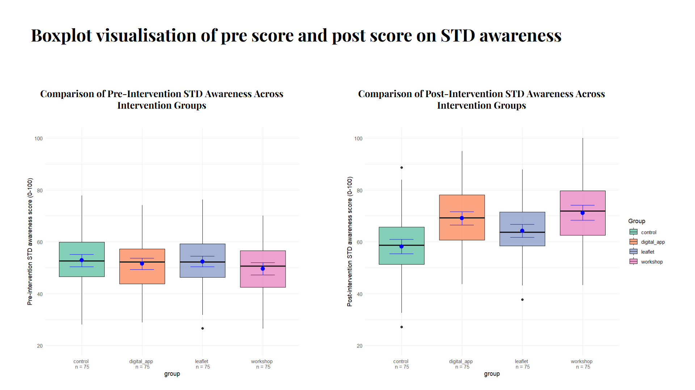
🧟 geom_boxplot () – continuous x categorical to show distribution of data across groups
ggplot(df_viz,
aes(x = ...,
y =...,
fill = ...) +
geom_boxplot ( )
``fill =`` Use the categorical variable to determine the inside fill color of each box.
Notes:
Use the age group to determine the inside fill color of each box.

Slide 59
To summarize - to create a graph using ggplot, it composes of 3 main components:
To make a beautiful one, just tell AI to help you :)

Slide 60

The session has come to the end, Thank you everyone for joining 😊, you are now certified R user !

